Slide 1

ST JOSEPH ENGINEERING COLLEGE An Autonomous Institution Department of Electronics and Communication Engineering STRESS DETECTION AND INTERVENTION
Sheline K V 4SO21EC094
Sneha Paikat 4S021EC106
Trisha Steeven S 4S021EC114
Veeksha K V 4SO21EC119
Guidance of
Under the Guidance of
Ms Preetha D’souza
Assistant Professor
of

Slide 2
Contents
Introduction
Literature review
Objectives
Methodology
Results and Discussion
Conclusion and future scope
References

Slide 3
Introduction
Stress is nothing but how our body reacts or body’s response to any kind of challenge.
Stress affects health, and early detection is important. We use machine learning to detect emotions by analyzing facial images.
Identifies stress levels by recognizing facial expression patterns linked to emotions.
stress detection by combining facial expressions and body signals.
Helps people in managing stress better and Raises awareness about mental health.
27/05/2025

Slide 4
Literature Review
Sl. No. | Paper title | Author name | Year | Key Points | Gaps Identified
1 | UBFC-Phys: A Multimodal Database For Psychophysiological Studies of Social Stress | Rita Meziati Sabour, Yannick Benezeth , Pierre De Oliveira, Julien Chappe, Fan Yang | 2023 | UBFC-Phys: Stress analysis with contact (BVP, EDA) and non-contact (RPPG) methods. 85.48% accuracy with remote PRV. Non-contact methods effective. | Noise limits analysis in dynamic tasks. Short durations restrict LF/HF evaluation. Need improved noise filtering and signal processing.
2 | A Review on Mental Stress Detection Using Wearable Sensors and Machine Learning Techniques | Shruthi Gedam, Sanchita Paul, | 2021 | ECG, EEG, GSR enable real-time stress detection. Machine learning improves analysis. Sensor fusion and deep learning enhance accuracy. | Enhance data integration and wearable stability. Research multiple biomarkers for better monitoring.
27/05/2025

Slide 5
Literature Review (contd…)
Sl. No. | Paper title | Author name | Year | Key Points | Gaps Identified
3 | Stress Detection with Machine Learning and Deep Learning using Multimodal Physiological Data | P. Bobade M. Vani | 2020 | ECG, BVP, and EDA. Stress, amusement, and neutral state classification. Achieved up to 95.21% accuracy. Machine learning and deep learning models effective. | Demographic variations impact generalization. Integrating GSR and heart rate enhances accuracy. Multimodal signals improve stress detection.
4 | Portable and wearable real-time stress monitoring: A critical review, Sensors and Actuators Reports | O Parlak | 2021 | Sensors: ECG, GSR, PPG. Non-invasive, user-friendly designs. Challenges: accuracy, battery life, comfort. | Cortisol correlation gaps in body fluids and blood. Biorecognition stability issues. Continuous sample handling challenges.
27/05/2025

Slide 6
Objectives
Train CNN, KNN, Random Forest, SVM, and FCN on a facial emotion dataset, evaluate their performance using accuracy and F1-score, and compare results to determine the best-performing model.
To classify stress using webcam images and GSR data and store the results in Firebase.
Combine emotion and GSR data to detect stress levels and create an app for personalized stress management.
27/05/2025

Slide 7
Literature Review (contd…)
Sl. No. | Paper title | Author name | Year | Key Points | Gaps Identified
5 | What's Your Current Stress Level? Detection of Stress Patterns from GSR Sensor Data | J. Bakker, M. Pechenizkiy and N. Sidorova, | 2011 | Stress detection using GSR data. Drift detection and noise management. Contextual integration for personalized recommendations. | Relies on GSR data only. Lacks contextual data, generalization, and noise handling. Addressing these gaps could improve reliability and usability.
6 | Review of stress detection method using wearable sensors, IEEE | G. Taskasaplidis,D. A. Fotiadis, and P. D. Bamidis | 2024 | Wearable technologies for stress assessment. Biological signals from the autonomic nervous system and HPA axis. Focus on physiological responses to stress. | Limited HPA biomarker integration in wearables. Using physical secretions for stress detection.
27/05/2025

Slide 8
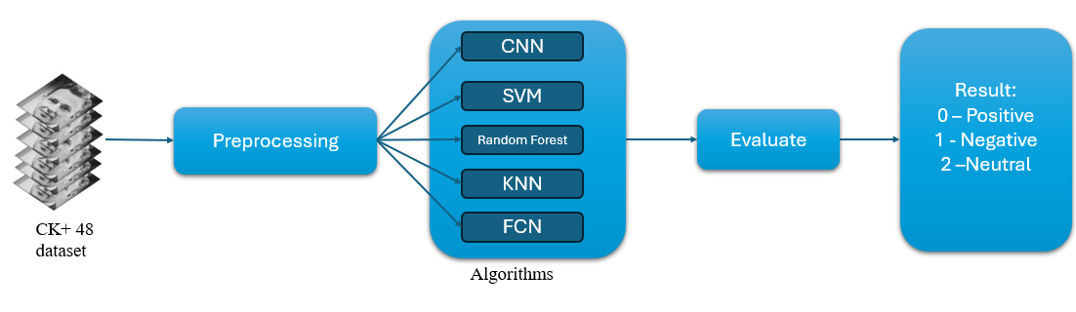
Methodology
Dataset: CK+ dataset with 981 grayscale images and 7 emotions (Anger, Contempt, Disgust, Fear, Happy, Sadness, Surprise).
Preprocessing: Converted to grayscale, resize to 48x48, normalize to [0, 1].
Labeling: One-hot encoding (3 classes: Positive, Negative, Neutral).
Split: 75% training, 25% testing.
CNN Model: Feature extraction, classification, Adam optimizer, 50 epochs, batch size 32.
Alternative Models: SVM, KNN, Random Forest, FCN.
Goal: Build an emotion recognition system using machine learning techniques.
27/05/2025

Slide 9
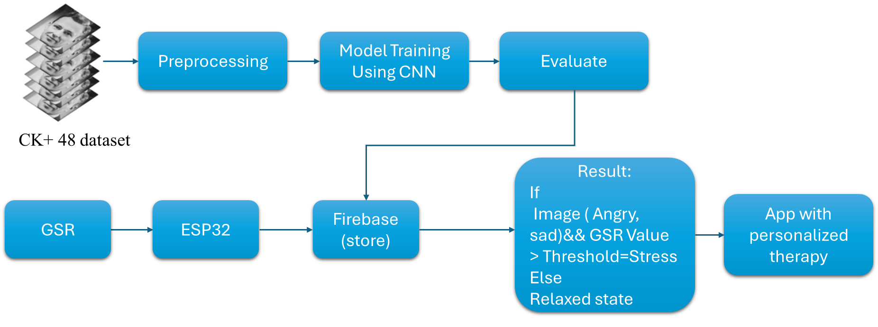
Methodology
27/05/2025

Slide 10
Methodology(Contd…)
Image Input
Facial images are taken (e.g., from webcam) and passed through a Convolutional Neural Network (CNN) model trained on the CK+48 dataset to detect emotions like angry, sad etc..
2. GSR Sensor (Stress Level Detection)
A GSR sensor connected via ESP32 collects data on skin conductivity, which increases under stress.
3. Data Storage
Both facial emotion and GSR readings are sent and stored on Firebase Realtime database..
4. Stress Evaluation
The app checks:
*If the emotion is angry or sad
*AND the GSR value is above a certain threshold,
>> then the user is considered to be under stress.
>> otherwise, they are in a relaxed state.
5. Personalized Therapy in App
Based on the result, the app provides personalized therapy suggestions, such as:
Yoga
Meditation
Music
Motivational messages
27/05/2025

Slide 11
Results and Discussion
Metric | Category | CNN | KNN | SVM | Random Forest | FCN
Accuracy | Overall | 0.99 | 0.89 | 0.94 | 0.99 | 0.73
 | Negative | 1.00 | 0.81 | 0.98 | 0.98 | 0.00
Precision | Positive | 0.97 | 0.95 | 0.96 | 1.00 | 0.96
 | Neutral | 1.00 | 0.87 | 0.88 | 1.00 | 0.53
 | Negative | 1.00 | 0.66 | 0.83 | 1.00 | 0.00
Recall | Positive | 1.00 | 0.78 | 0.99 | 1.00 | 0.97
 | Neutral | 0.99 | 0.67 | 0.94 | 0.92 | 0.95
 | Negative | 1.00 | 0.83 | 0.90 | 0.99 | 0.00
F1 Score | Positive | 0.99 | 0.94 | 0.97 | 1.00 | 0.96
 | Neutral | 0.99 | 0.88 | 0.99 | 0.99 | 0.68
27/05/2025

Slide 12
Results and Discussion(contd…)
CNN and Random Forest are the top-performing algorithms.
SVM performs well but slightly lags behind.
KNN shows moderate performance, struggling with recall for certain classes.
FCN fails significantly in classifying Negative and Neutral categories.
CNN is the best overall algorithm, demonstrating consistent performance across Precision, Recall, and F1 Score for all sentiment categories.
Software Implementation
•Trained Model Integration: A trained model was utilized alongside the DeepFace module for face detection and emotion identification.
•Emotion Classification: Emotions like 'angry' and 'sad' were categorized as stress indicators.
•Other Emotions: Remaining emotions were retained in their original categories.
27/05/2025

Slide 13
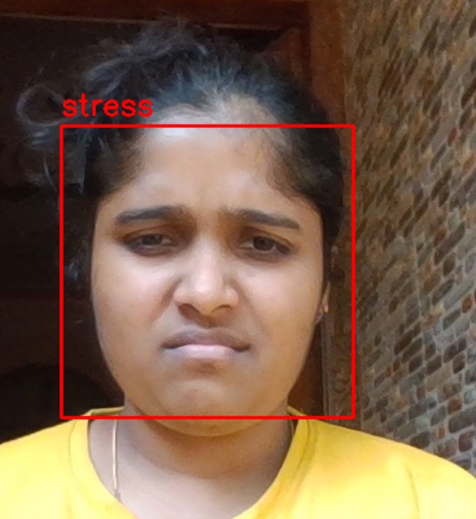
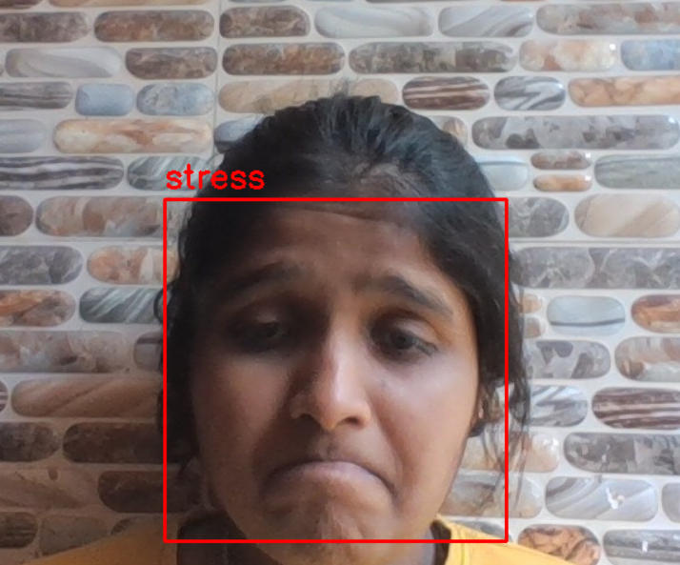
Results and Discussion(contd…)
Results from webcam images
Fig 1.1 Image with angry and sad emotion classified as stress
27/05/2025
Stress detection and intervention

Slide 14
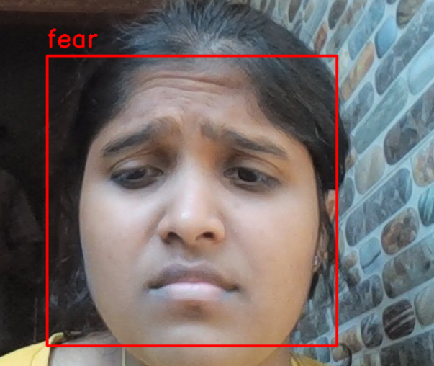
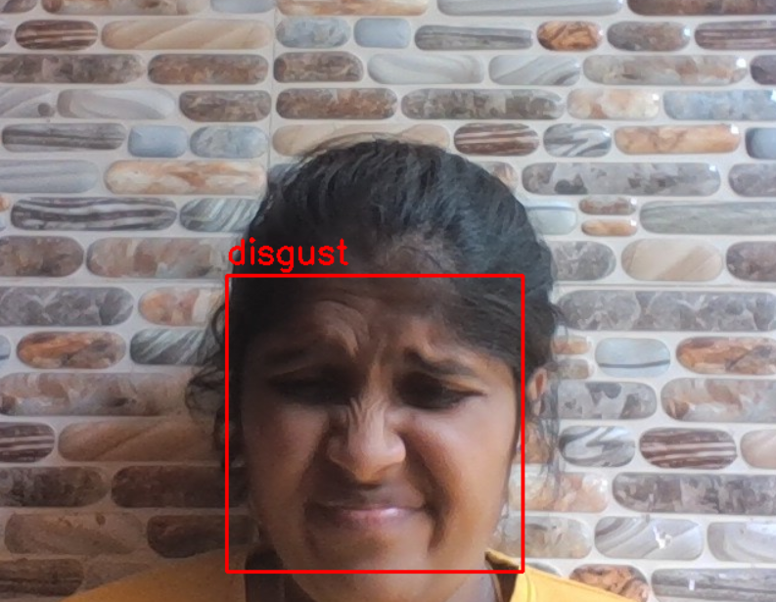
Results and Discussion(contd…)
Fig 1.2 Images with fear and disgust emotions
27/05/2025
Stress detection and intervention

Slide 15
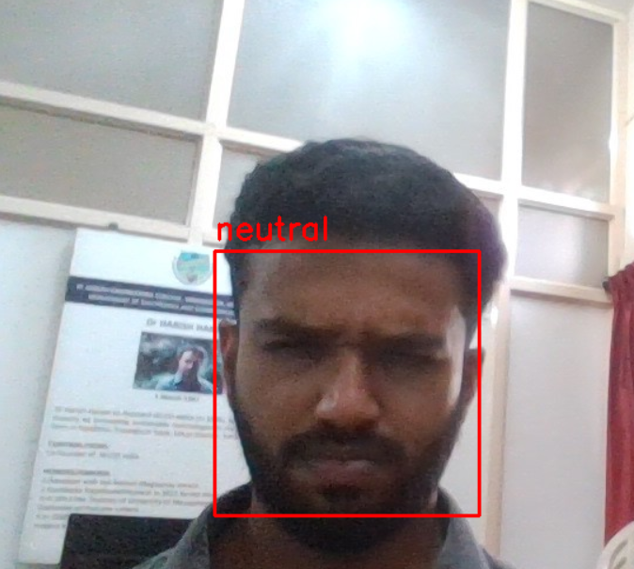
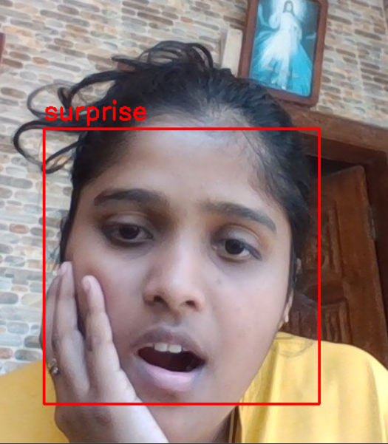
Results and Discussion(contd…)
Fig 1.3 Images with neutral and surprise emotions
27/05/2025
Stress detection and intervention

Slide 16
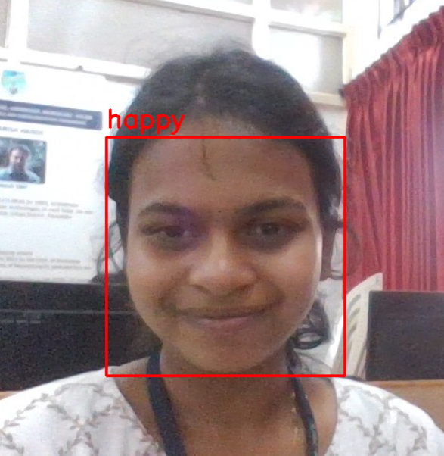
Results and Discussion(contd…)
Fig 1.4 Image with happy emotion
27/05/2025
Stress detection and intervention

Slide 17
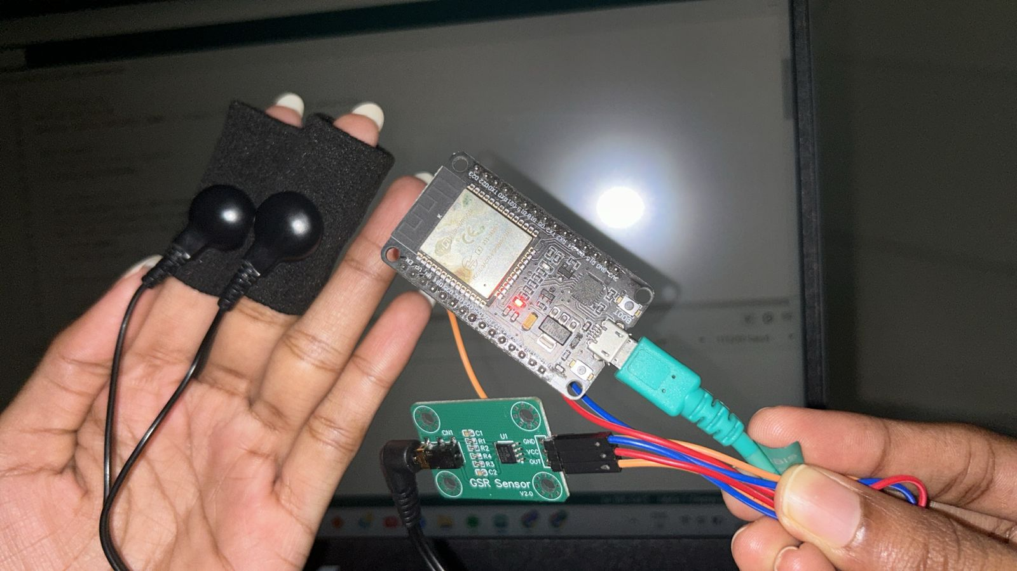
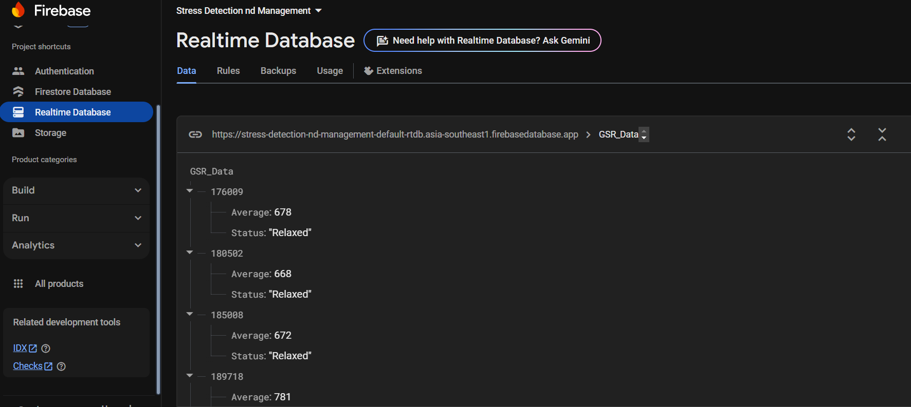
Results and Discussion(contd…)
Hardware Implementation
Hardware implementation
GSR Data Visualization in Firebase Realtime Database
27/05/2025
Stress detection and intervention

Slide 18

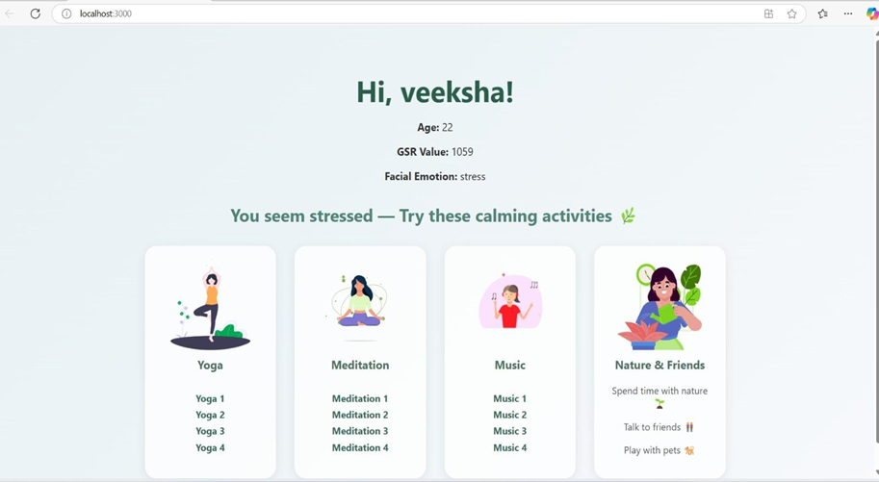
Results and Discussion
Results obtained from Work
(a) (b)
Fig:Images demonstrating the working of the app
27/05/2025

Slide 19
Conclusion
Developed a stress detection system using facial emotions and GSR sensor data.
CNN outperformed KNN, SVM, Random Forest, and FCN in accuracy and F1-score.
Real-time data captured via webcam and ESP32; results uploaded to Firebase.
System offers scalable, accurate, and personalized stress monitoring.
Future plans include making the system portable, wearable-friendly, and cost-effective.
We have participated in 16th International Conference on Recent Engineering and Technology (ICRET 2025), an annual hybrid international conference focusing on advancements in engineering and technology and presented our research paper.
27/05/2025

Slide 20
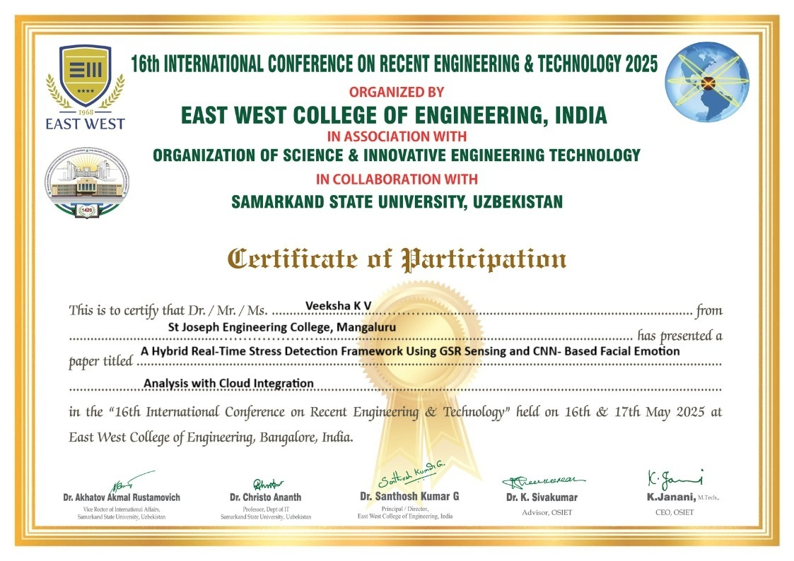
Conference Participation Certificate
Stress detection and intervention

Slide 21
Future scope And Implications
Integrate with wearables like smartwatches for continuous real-time stress monitoring.
Include additional signals (heart rate, voice, EEG) for enhanced detection accuracy.
Collaborate with healthcare providers for clinical validation and medical use.
Train on diverse datasets to improve model fairness and inclusivity.
Enable stress monitoring in workplaces and schools for well-being programs.
Provide valuable data for behavioral and psychological research.
27/05/2025

Slide 22
References
[1] R. M. Sabour, Y. Benezeth, P. De Oliveira, J. Chappée, and F. Yang, "UBFC-Phys: A Multimodal Database for Psychophysiological Studies of Social Stress," IEEE Transactions on Affective Computing, vol. 14, no. 1, pp. 622–634, Jan.-Mar. 2023, doi: 10.1109/TAFFC.2021.3056960.
[2] J. Bakker, M. Pechenizkiy, and N. Sidorova, "What's Your Current Stress Level? Detection of Stress Patterns from GSR Sensor Data," 2011 IEEE 11th International Conference on Data Mining Workshops, Vancouver, BC, Canada, 2011, pp. 573-580, doi: 10.1109/ICDMW.2011.178.
[3] O. Parlak, "Portable and wearable real-time stress monitoring: A critical review," Sensors and Actuators Reports,vol.3,p.100036,2021,doi: 10.1016/j.snr.2021.100036.Available:https://doi.org/10.1016/j.snr.2021.100036.
[4] G. Ribeiro, O. Postolache and F. F. Martín, "A New Intelligent Approach for Automatic Stress Level Assessment Based on Multiple Physiological Parameters Monitoring," IEEE Transactions on Instrumentation and Measurement, vol. 73, pp. 1-14, 2024, Art no. 4001714, doi: 10.1109/TIM.2023.3342218.
27/05/2025

Slide 23
References(contd…)
[5] Hosseini, R. Fang, R. Zhang, S. Rafatirad, and H. Homayoun, "Emotion and Stress Recognition Utilizing Galvanic Skin Response and Wearable Technology: A Real-time Approach for Mental Health Care," in 2023 IEEE International Conference on Bioinformatics and Biomedicine (BIBM), Istanbul, Turkiye, 2023, pp. 1125-1131. doi: 10.1109/BIBM58861.2023.10386049.
[6] S. Gedam and S. Paul, "A Review on Mental Stress Detection Using Wearable Sensors Machine Learning Techniques," IEEE Access, vol. 9, pp. 84045-84066, 2021, doi: .1109/ACCESS.2021.3085502.
[7] G. Taskasaplidis, D. A. Fotiadis, and P. D. Bamidis, "Review of Stress Detection Methods Using Wearable Sensors," IEEE Access, vol. 12, pp. 38219-38246, 2024, doi: 10.1109/ACCESS.2024.3373010.
[8] H. P. Chandika, B. Soumya, B. N. E. Reddy, and B. M. S. S. Manideep, "Real-Time Stress Detection and Analysis using Facial Emotion Recognition," International Journal of Advanced Research in Computer and Communication Engineering, vol. 13, no. 3, pp. 158-172, Mar. 2024, doi: 10.17148/IJARCCE.2024.13324.
27/05/2025

Slide 24
References(contd…)
[9] P. Bobade and M. Vani, "Stress Detection with Machine Learning and Deep Learning using Multimodal Physiological Data," 2020 Second International Conference on Inventive Research in Computing Applications (ICIRCA), Coimbatore, India, 2020, pp. 51-57, doi: 10.1109/ICIRCA48905.2020.9183244.
[10] M. Pediaditis et al., "Extraction of facial features as indicators of stress and anxiety," in 2015 37th Annual International Conference of the IEEE Engineering in Medicine and Biology Society (EMBC), Milan, Italy, 2015, pp. 3711-3714. doi: 10.1109/EMBC.2015.731919.
[11] L. Santamaria-Granados, M. Munoz-Organero, G. Ramirez-González, E. Abdulhay, and N. Arunkumar, "Using Deep Convolutional Neural Network for Emotion Detection on a Physiological Signals Dataset (AMIGOS)," IEEE Access, vol. 7, pp. 57-67, 2019. doi: 10.1109/ACCESS.2018.2883213.
27/05/2025

Slide 25
THANK YOU
27/05/2025

